Slide 1
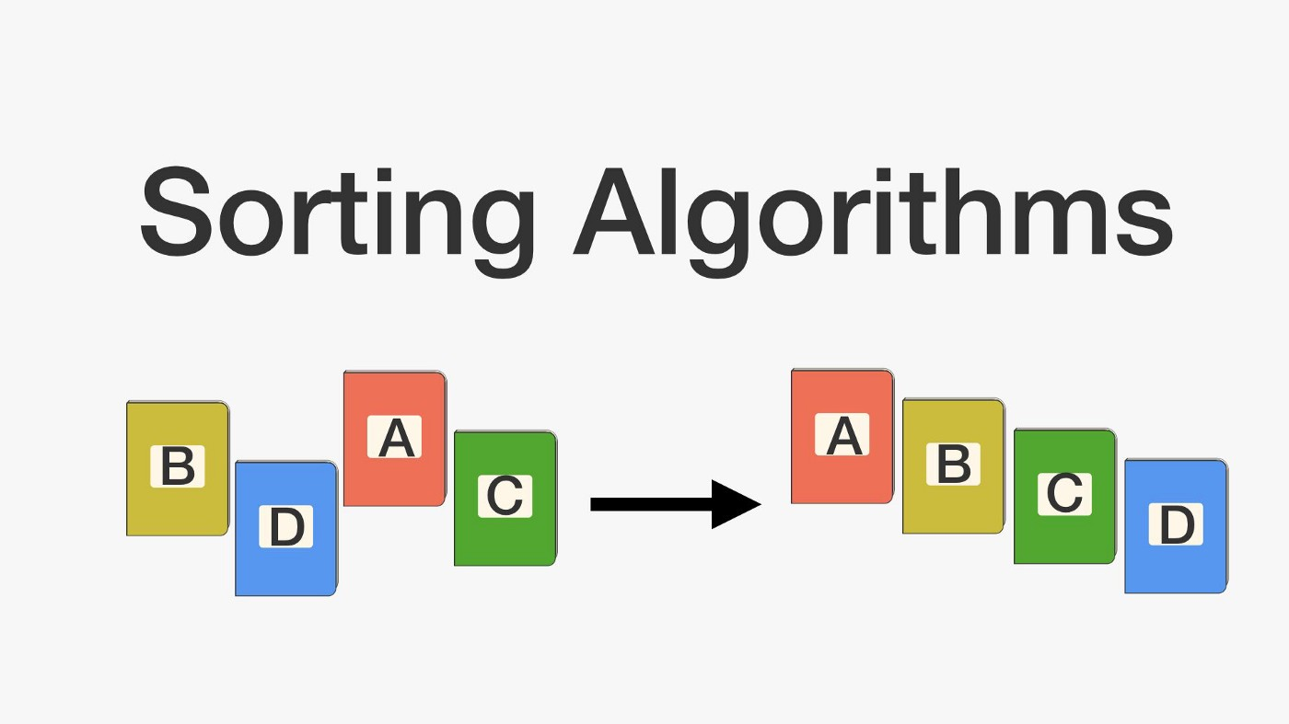
Sorting techniques
01

Slide 2





Team Members
x8086 assembly language project
Hala Alaa Eldin
Shrouk Abdallah
Sara Mohamed
Mohamed Khaled
Mahmoud Kamal
BN:70
BN:22
BN:20
BN:45
BN:53

Slide 3
Agenda
Introduction about sorting techniques
Bubble sort & Selection sort
Assembly project

Slide 4

Introduction
Sorting Algorithms are methods of reorganizing a large number of items into some specific order such as lowest to highest, or vice-versa, or even in some alphabetical order.
These algorithms take an input list, processes it and produce the sorted list.
Sorting techniques used in our project:
Bubble Sort
Selection Sort

Slide 5
Bubble Sort
Sometimes referred to as sinking sort, is a simple sorting algorithm that repeatedly steps through the list, compares adjacent elements and swaps them if they are in the wrong order. The pass through the list is repeated until the list is sorted.

Slide 6
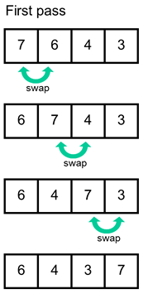
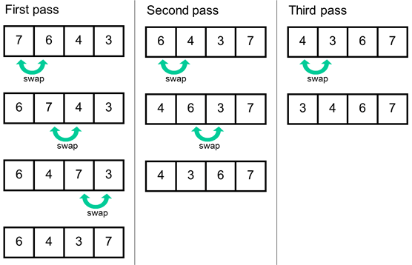

Slide 7
Selection Sort
Selection sort is another algorithm that is used for sorting. This sorting algorithm, iterates through the array and finds the smallest number in the array and swaps it with the first element if it is smaller than the first element. Next, it goes on to the second element and so on until all elements are sorted.

Slide 8
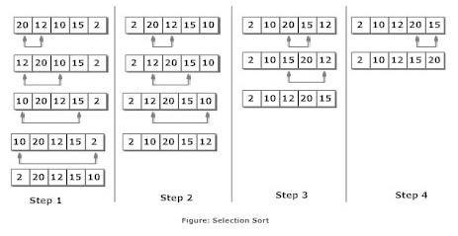

Slide 9
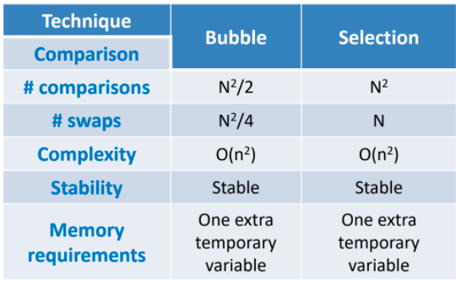
Comparison between Bubble sort and Selection sort

Slide 10
Assembly code procedures
1
2
3
4
5
Main procedure:
This function prints messages for the user to enter the array size and elements, then call each function in its turn
CONDITION procedure:
The function asks the user to select the type of sort 1 for Bubble, 2 for Selection. Otherwise, an error message will be printed and the user should input a digit correctly.
DECIMALFORM procedure& SIGNED procedure:
DECIMAL function reads the elements of the arrays in its decimal form and checks for any wrong character the user entered, SIGNED function will display a number in a decimal form
ArraySize procedure:
This function reads the size of array (ONLY POSITIVE INTEGER NUMBER) that the user entered and prints a warning message if any wrong character entered
ReadArray procedure and PrintArray procedure:
ReadArray function reads elements for a given array and PrintArray function displays the elements of array in screen

Slide 11
Work Distribution
Name | Function
Sara Mohamed | ReadArray , PrintArray
Mahmoud Kamal | CONDITION ,error handling
Mohamed Khaled | CONDITION , error handling
Hala Alaa Eldin | DECIMALFORM
Shrouk Abdallah | ArraySize, SIGNED

Slide 12
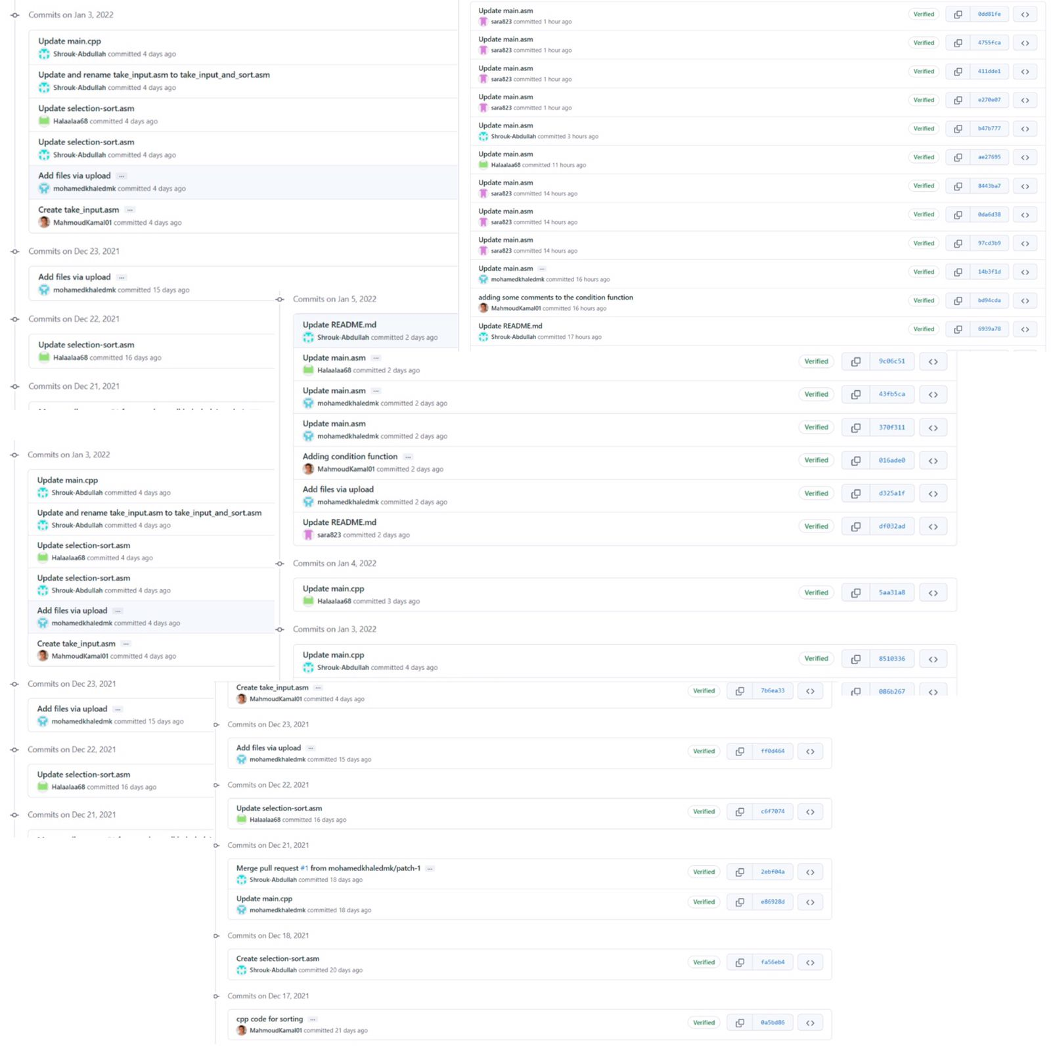
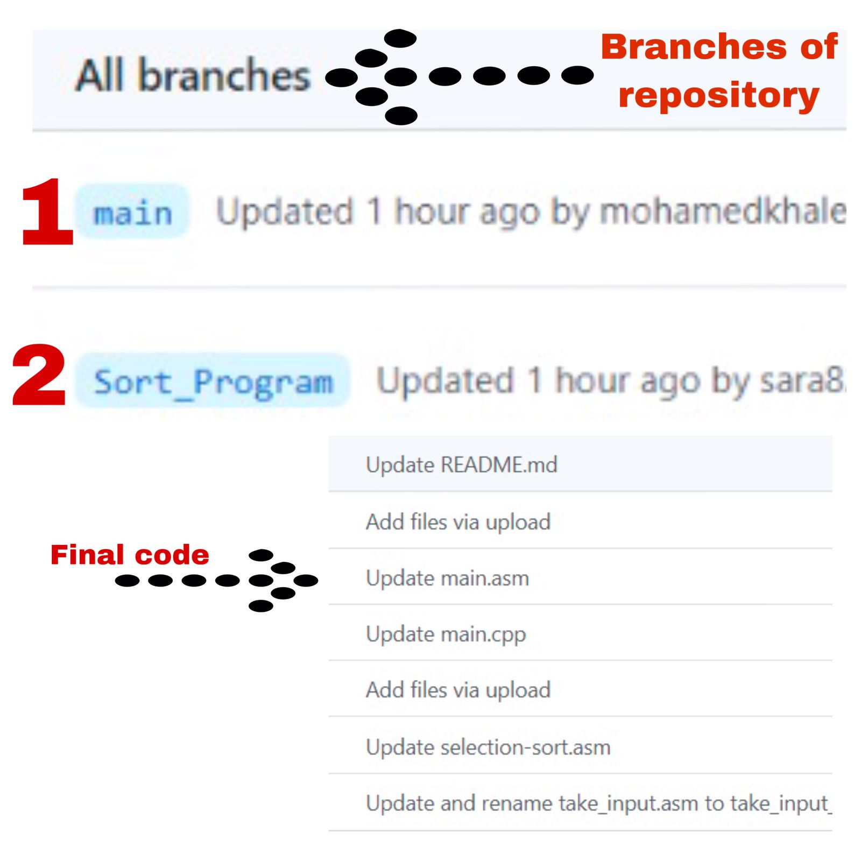
About Github
Brief about our repository

Slide 13
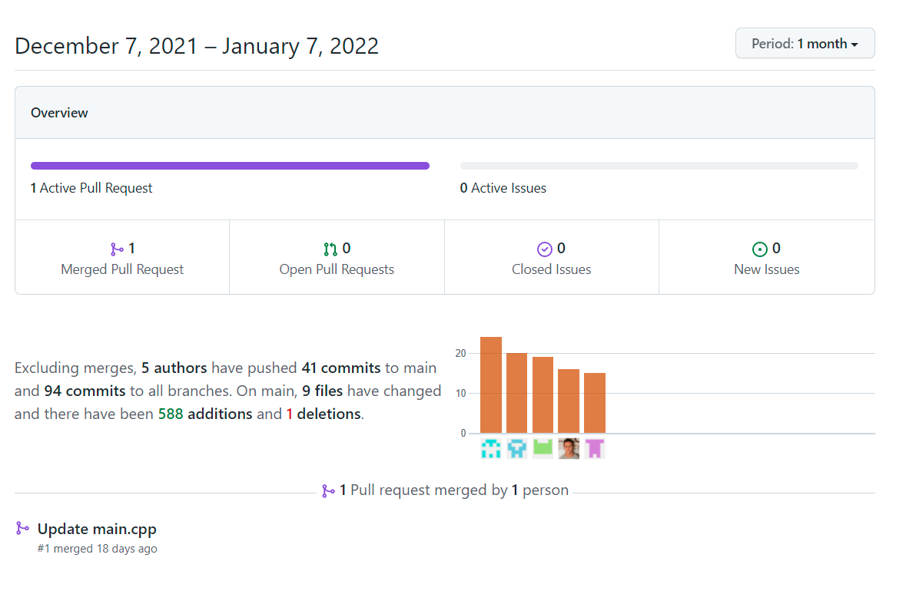
About Github
Brief about our graph during 1 month

Slide 14
Thank you!

